Slide 1
Unit 9
Decision Analytics

Slide 2
Activity 1
In Live Session for Unit 8, you worked on fitting three or four different models to the Readmit Data.
This assignment is included for reference on the next slide.

Slide 3
Assignment
Meet your Group
Spend some time with the data. Just peruse, visualize and discuss.
You have 3 or 4 people in your group. Each group member use ChatGPT or Gemini or other LLM fit the models below. Ask it to evaluate the model based on accuracy, sensitivity, specificity, AUC and F1 score. Also ask it to generate the R or Python code to generate these statistics.
Fit a Logistic Regression Model
Fit a Normal Random Forest Model
Fit an XGBoost Random Forest Model
Fit a Neural Network Based Model
Use the code generated above to validate the calculations coming out of ChatGPT
Use your model to assess the association of the the most significant variable in your model.
Using the default format in PowerPoint, make a group PowerPoint presentation that includes:
Title Slide
One slide describing the results of each team member.
A slide at the end comparing the results based on accuracy, sensitivity, specificity, AUC and F1 score
A conclusion slide that thanks the audience and prompts for questions.
Make sure that each slide has a similar look and feel… same format … same font … no grammar error or misspellings.
Practice if you have time … you will have 5 minutes to present your findings. 1 minute for opening and closing and 1 minute each for each presenter.

Slide 4
Activity 1
For Unit 9 Live Session, please add a slide to your presentation that addresses the business case / business value that could be derived from this analysis.
Please see the next slide for the details.

Slide 5
Follow Up! ☺
Many if not most presentations to the C-Suite consist of answering two questions:
What specifically do I need to do to create value?
How much value will it create?
How many lives will it save?
or … How much money will it save or make?
or … How much time will it save or create?
Your final goal is to make one slide and place it between the summary slide and the conclusion slide that make a business case to the C-Suite … that is … answers questions 1 and 2 above.
Valuable Information: Each re-admit costs $150,000 due to longer ICU stays and more involved treatment on average. However, the hospital can hold the patient for another 5 days for $10,000 to reduce the chance of a readmit.

Slide 6
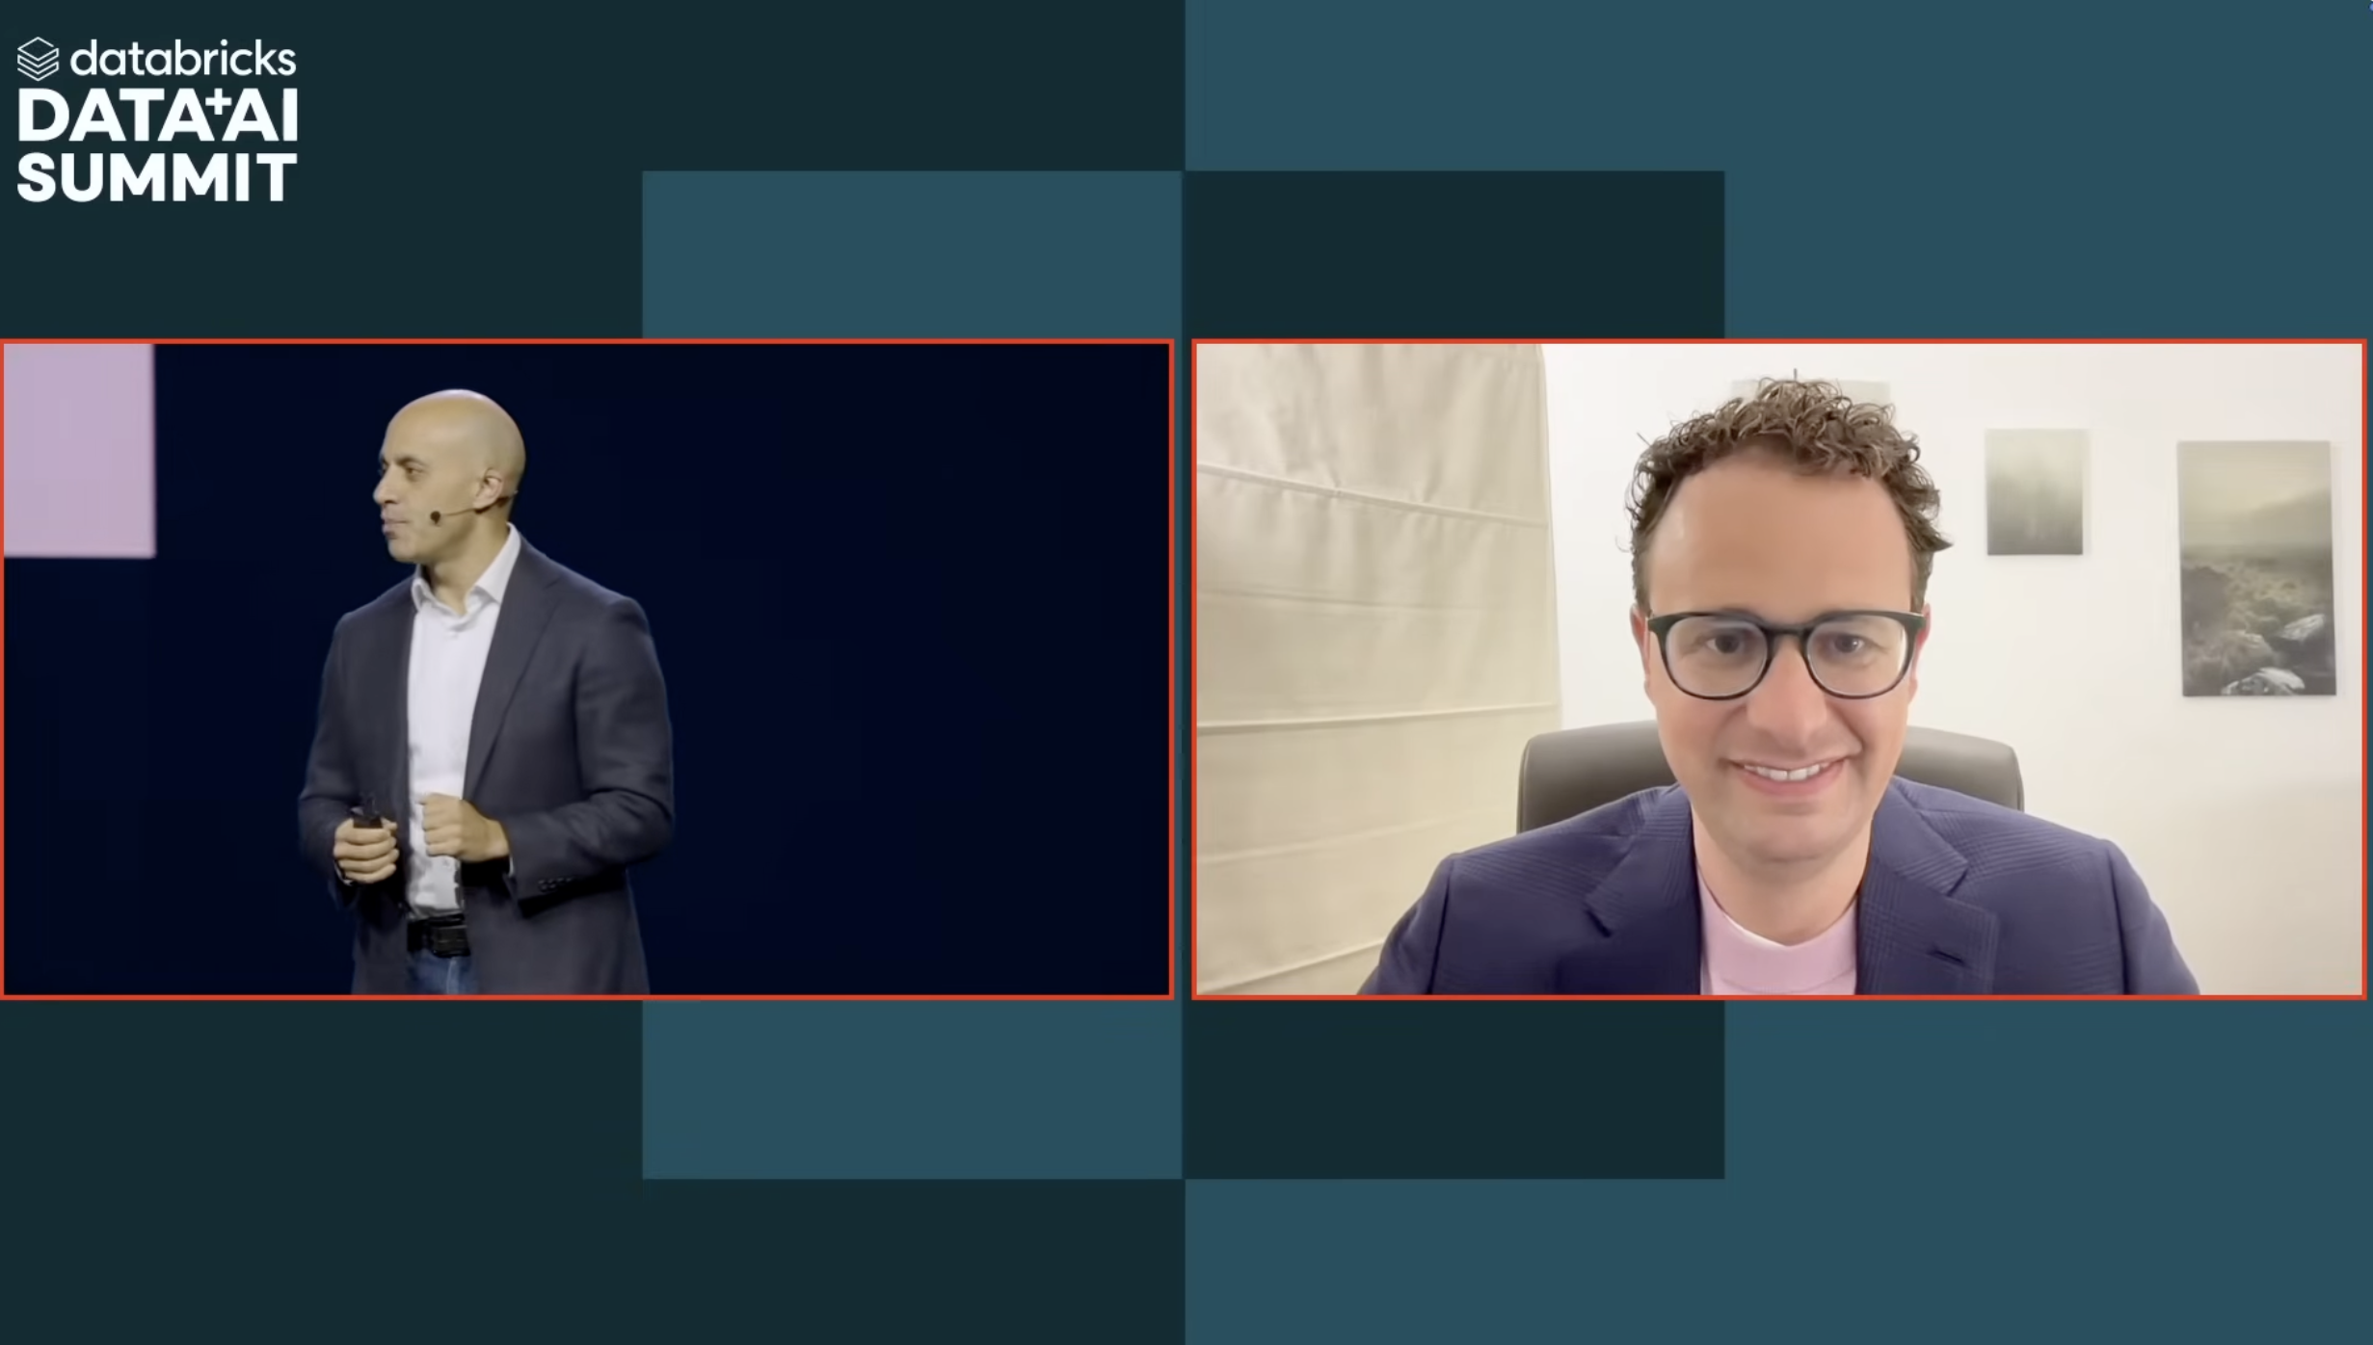
Activity 2: Databricks Keynote!
Please watch the following clips included on the following slides from the Databricks Data and AI Summit that occurred June 9 to June 13, 2025 in San Francisco.

Slide 7
Anthropic: Dario
Please carefully watch and enjoy this interview with Greg Ulrich:
https://youtu.be/ul8cRLIP_Vk?t=4551
Just watch till the end of the interview and answer the questions below in preparation for a discussion in class.
Who is Dario Amodei?
What is Vibe Coding?
What do you think was the most impactful message from his talk?

Slide 8
Master Card: Greg Ulrich
Please carefully watch and enjoy this interview with Greg Ulrich:
https://youtu.be/ul8cRLIP_Vk?t=7354
Just watch till the end of the interview and answer the questions below in preparation for a discussion in class.
Who is Greg Ulrich
What were your top takeaways from this Interview?

Slide 9
JP Morgan Chase: Jamie Dimon
Please carefully watch and enjoy this interview with Jamie Dimon:
https://youtu.be/ul8cRLIP_Vk?t=7764
Just watch till the end of the interview and answer the questions below in preparation for a discussion in class.
Who is Jamie Dimon?
What were your top takeaways from this Interview?

